Slide 1
Journey at 2024 Wells Fargo Data Science Camp

Slide 2
Overview of the journey in this week
Platform Set-ups
(Google Colab/Lintcode)
Style Transfer Example (optional)

Slide 3
1-week journey
Day
Morning
Intro to Data Science/Set-up in Google Colab
Afternoon
Python
Monday
Intro to Models
Tuesday
Advanced Modeling I (Linear Models, Neural Networks)
Wednesday
Advanced Modeling II (Convolutional Neural Networks, Tree-based Models)
Project: model initialization and structure design
Project: introduction and data collect
Thursday
Project: Model parameter tuning and optimization
Friday
Project: Preparation and Final Presentation
All the teaching materials are given at: https://github.com/RudyMartin/dsai-2024

Slide 4
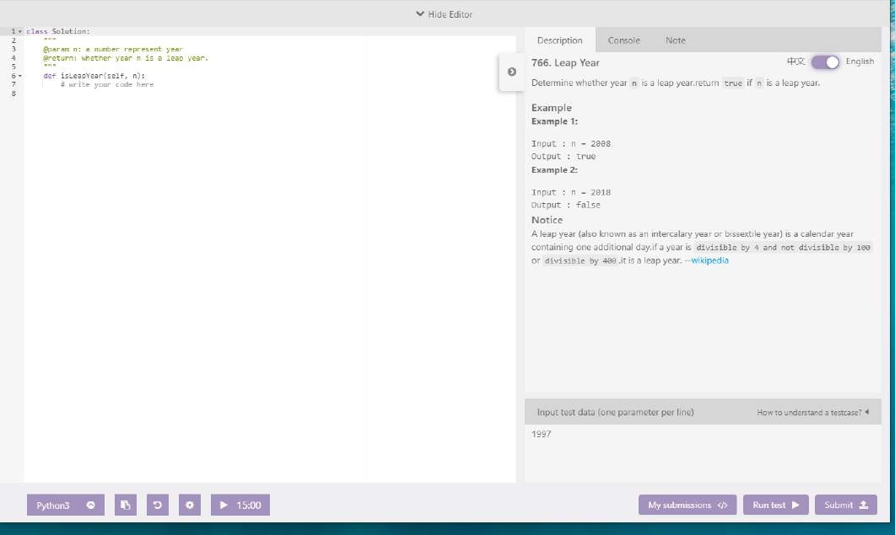
Python Programming- practice on lintcode.com (sign up a Free account now)
Github location:
https://github.com/RudyMartin/dsai-2024/tree/main/MVPS/Session-Materials/Python%20Programming
www.lintcode.com

Slide 5




Advanced Model (Linear Regression to Neural Networks)
Part I: Linear Models
Part II: Neural Networks
Linear regression
Generalized linear models
Multilayer neural networks
Logistic regression
Single-layer neural networks
Convolutional neural networks
Tree based
models
Github:
https://github.com/RudyMartin/dsai-2024/tree/main/MVPS/Session-Materials/Advanced%20Models%20I

Slide 6





Advanced Modeling (Neural Networks, tree-based model)
Convolutional
neural networks ^{Tree based}
models
Linear regression
Generalized linear models
Multilayer neural networks
Logistic regression
Single-layer neural networks
NN: https://github.com/RudyMartin/dsai-2024/blob/main/MVPS/Session-Materials/Advanced%20Models%20I/Neural_Networks_Introduction.ipynb
Tree model: https://github.com/RudyMartin/dsai-2024/tree/main/MVPS/Session-Materials/Advanced%20Models%20II/Tree-Based%20Models

Slide 7
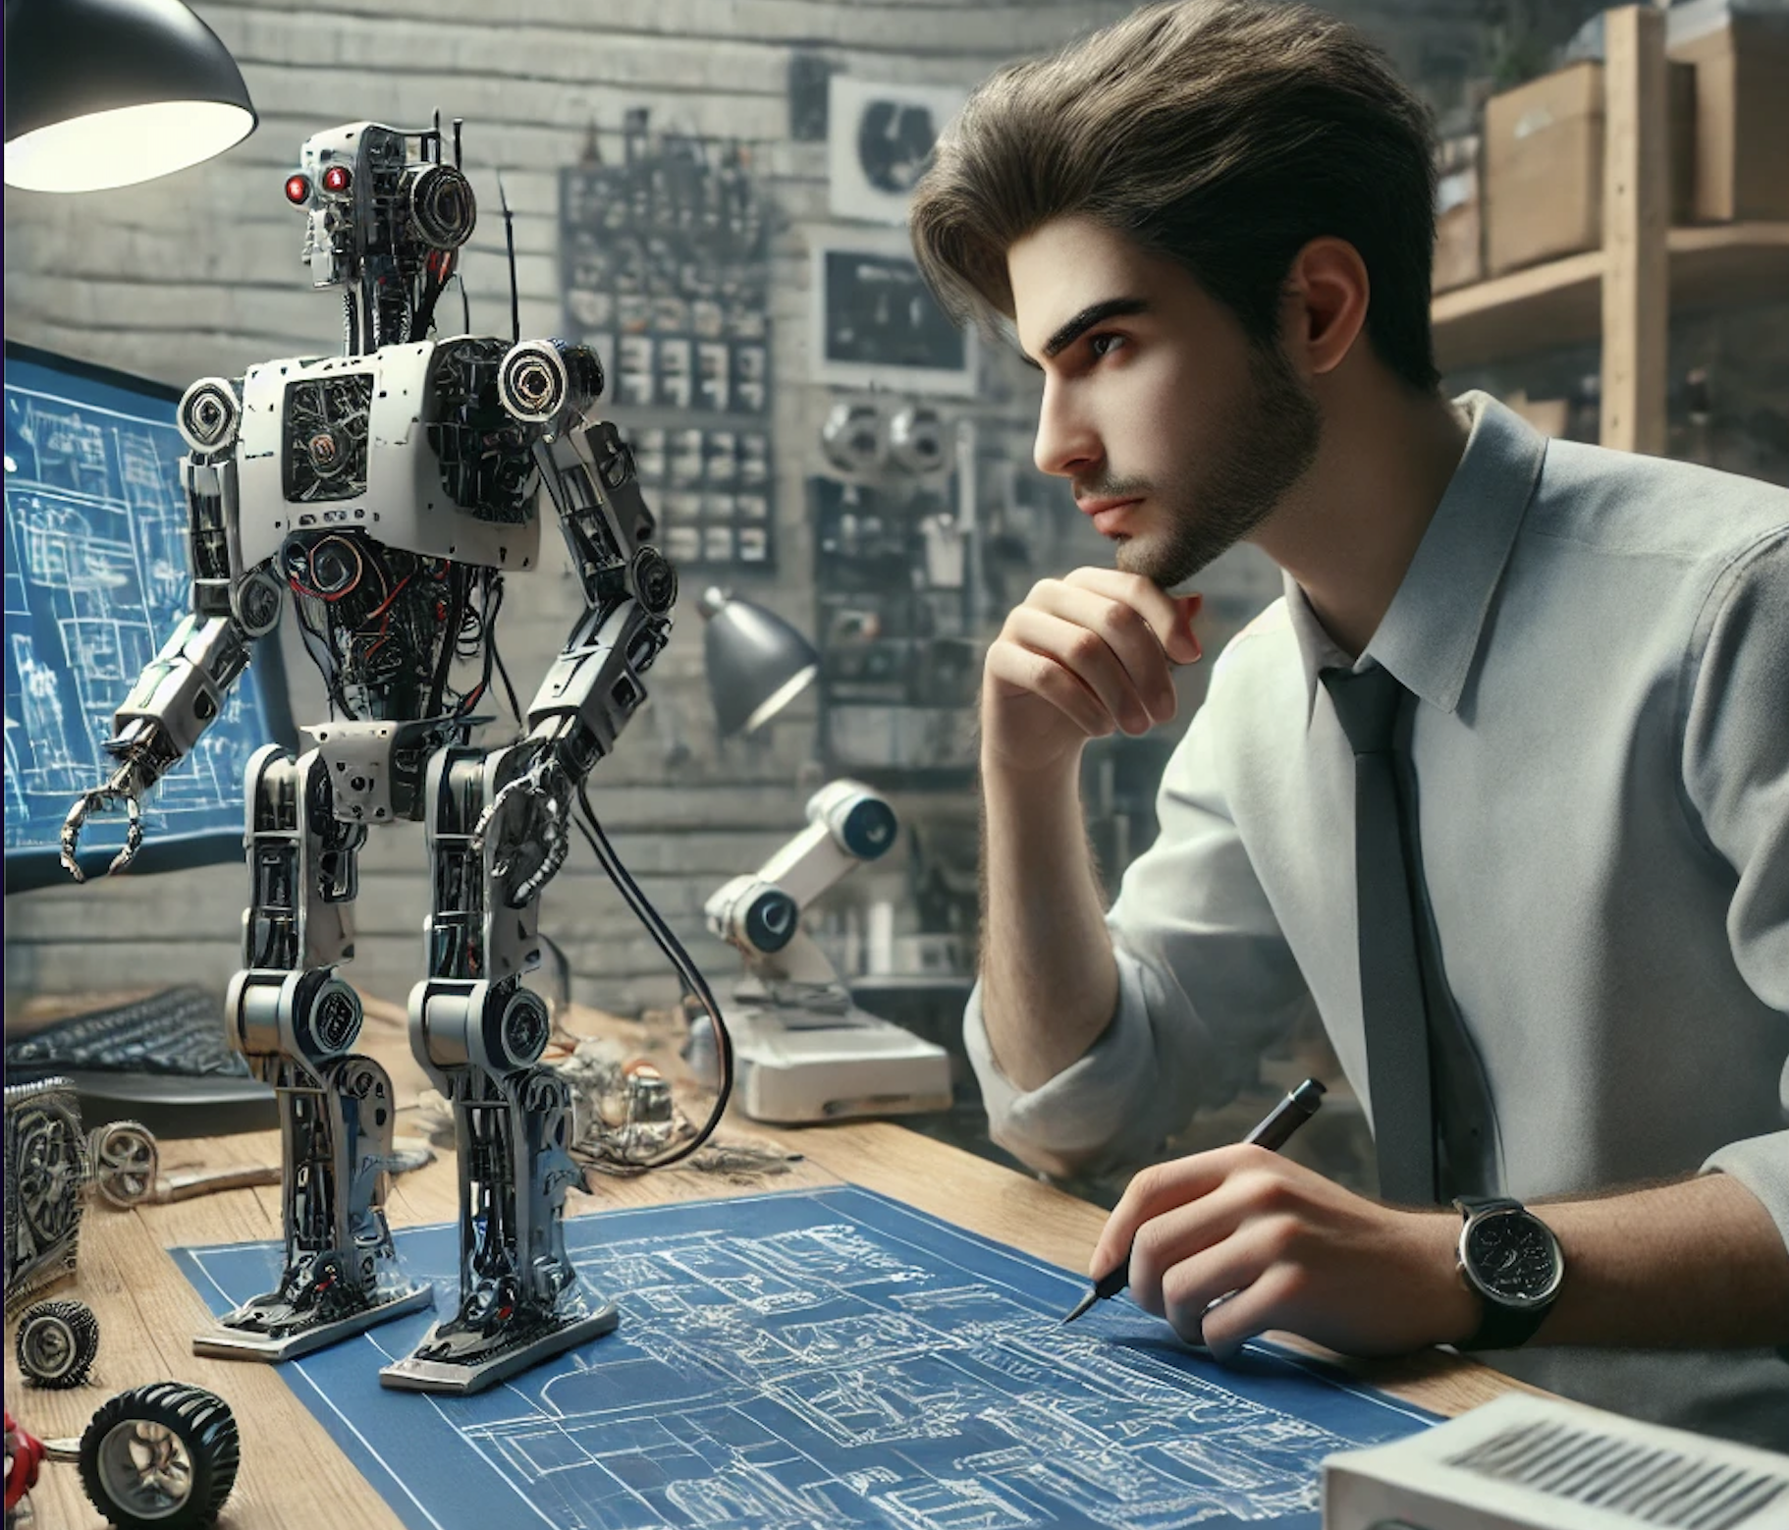
Artificial Neural Networks Today
AutoML and Neural Architecture Search: Imagine you have to build the best robot for a science competition. Instead of figuring out all the parts and design yourself, you use a smart system that can automatically pick the best parts and design for your robot. This saves you time and effort and ensures you get a great result.
Dueling Neural Networks: Think of two video game players who are constantly competing against each other. By challenging one another, they both get better at the game. In AI, we use a similar idea where two computer brains compete to improve their skills, which helps create smarter game AIs.
Neuroscience-based Deep Learning: This is like studying how our brain works to build better computer brains. By understanding how neurons in our brain connect and communicate, scientists create more advanced and capable AI models.
Enhanced Personalization: Imagine an online store or a streaming service that knows exactly what you like and gives you perfect recommendations every time. AI helps make this happen by learning your preferences and suggesting things tailored just for you
Hybrid Models: Picture combining a superhero with super strength and one with super speed to create an ultimate hero with both abilities. In AI, we mix different types of neural networks to solve complex problems more effectively, just like combining different superhero powers.
AutoML for Robotics
https://www.youtube.com/shorts/DB1027Bfpmo

Slide 8
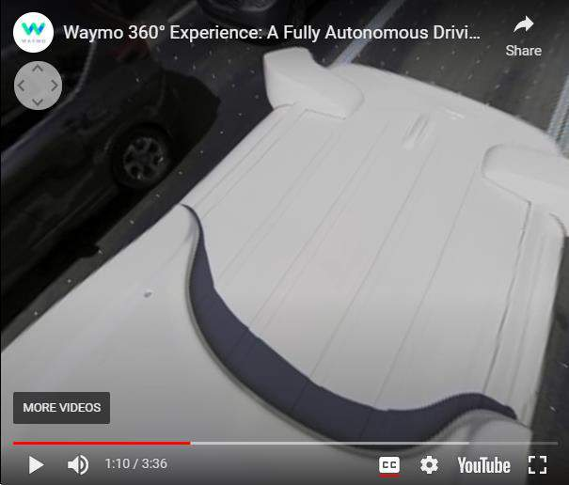
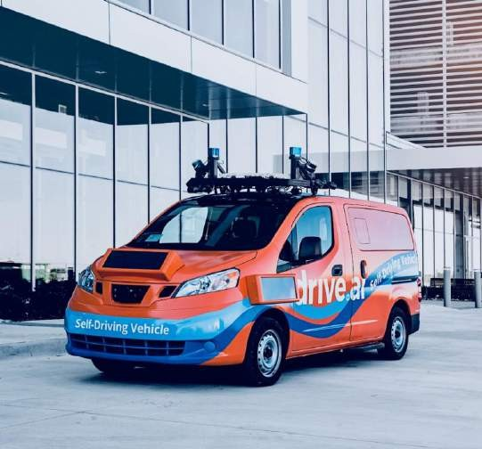
Artificial Neural Networks Today
AI Driving Cars
Self-driving vehicles are often powered by neural
networks
Used to recognize objects on the road and to make decisions
https://medium.com/@andrewng/self-
Link to video:
https://www.youtube.com/watch?v=B8R148hFxP
9
driving-cars-are-here-aea1752b1ad0

Slide 9
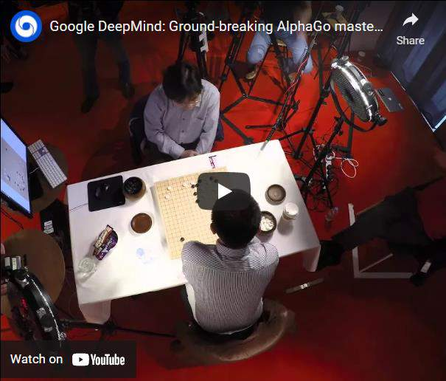
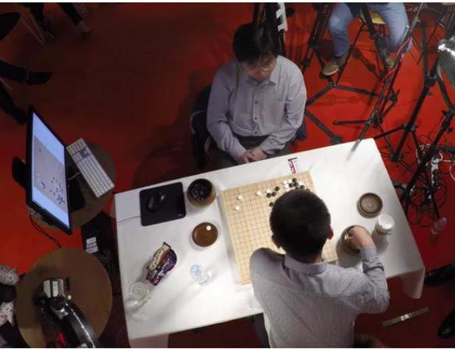
Artificial Neural Networks Today
AI Playing Go
Over a googol times as many board states as chess
Intuitive play
DeepMind defeated first ranked player Ke Jie in May
2017
https://blog.google/technology/ai/al
Link to video:
phago-machine-learning-game-go/
https://www.youtube.com/watch?v=SUbqykXVx0
10

Slide 10
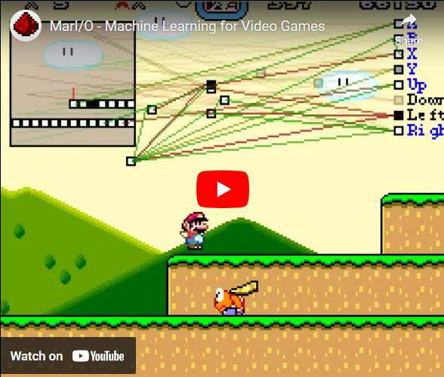
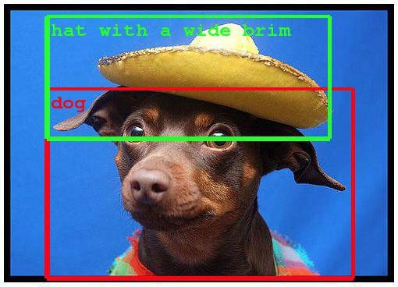
Artificial Neural Networks Today
Object Recognition
Learn to recognize objects in complicated images, videos,
or even video games
https://ai.googleblog.com/2014/09/buildi
ng-deeper-understanding-of-images.html
Link to video:
11
https://www.youtube.com/watch?v=qv6UVOQ0F4

Slide 11

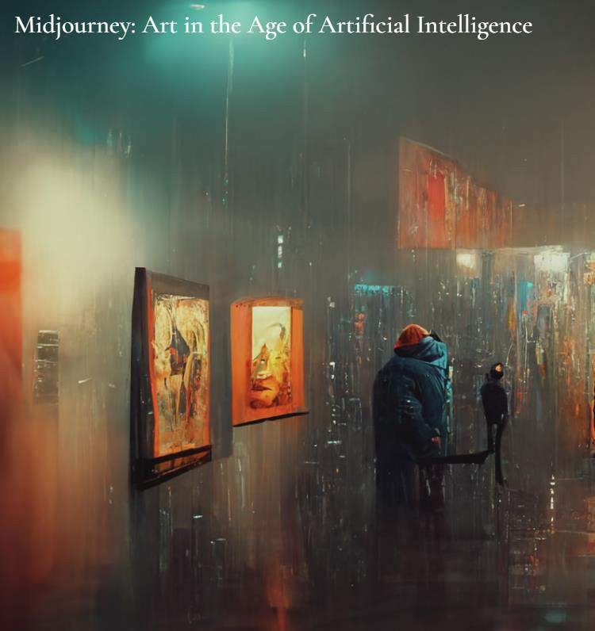
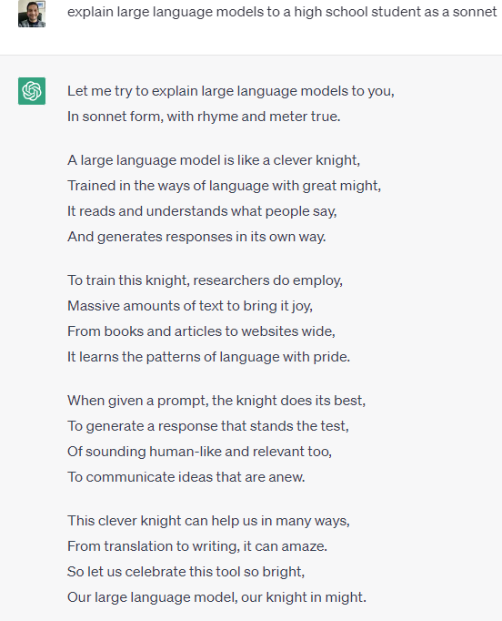
Artificial Neural Networks Today

Slide 12
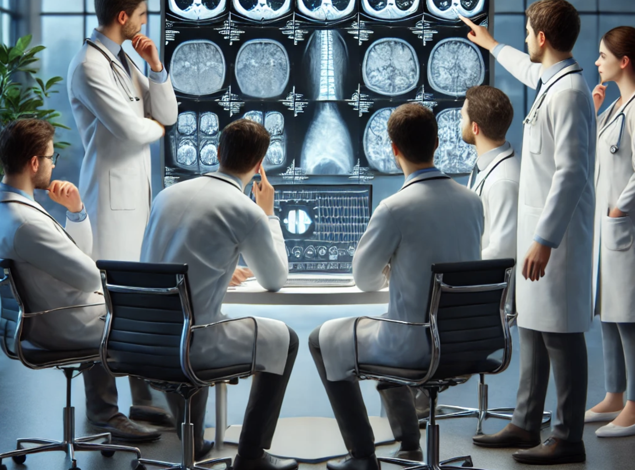
Convolutional Neural Networks
Applications
Vision Transformers (ViT): Imagine you have a new kind of camera that can understand pictures better than the old ones. Instead of using traditional methods, it uses a smart system called a transformer to look at pictures in a new way. Sometimes, this new system can do a better job at recognizing what's in the pictures.
Real-time Object Detection: Think about a self-driving car that can see everything around it while moving. It uses a smart system (CNNs) to quickly spot and identify objects like people, cars, and signs in live video feeds. This is crucial for safe driving and security cameras.
Super-resolution Imaging: Imagine you have a blurry photo, and you want to make it clear and sharp. Using a smart system (CNNs), we can enhance the resolution of images, making them clearer. This is especially helpful in medical imaging to see details more clearly and in improving old, low-resolution photos.
Generative Adversarial Networks (GANs): Think of two artists competing to create the best paintings. One artist tries to make realistic pictures, while the other tries to spot mistakes. By competing, they both get better. GANs use this idea to create realistic images, audio, and video, which is great for making new content and enhancing existing ones.
Biomedical Image Analysis: Imagine doctors looking at X-rays or MRI scans to find out what's wrong with a patient. CNNs help analyze these medical images quickly and accurately, helping doctors diagnose and plan treatment for various diseases more effectively.
Biomedical Image Analysis - MONAI
https://www.youtube.com/watch?v=YHTSdd8-bnc

Slide 13
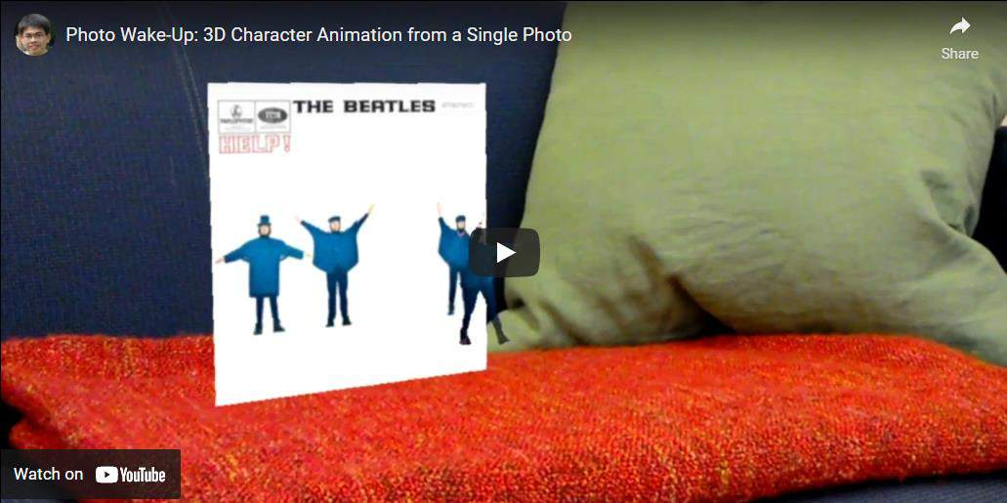
Convolutional Neural Networks
Applications
Photo Wake-Up
Link to video: https://youtu.be/G63goXc5MyU

Slide 14
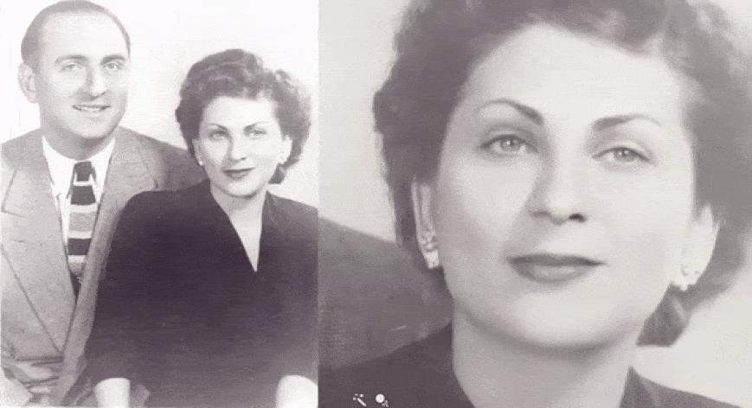
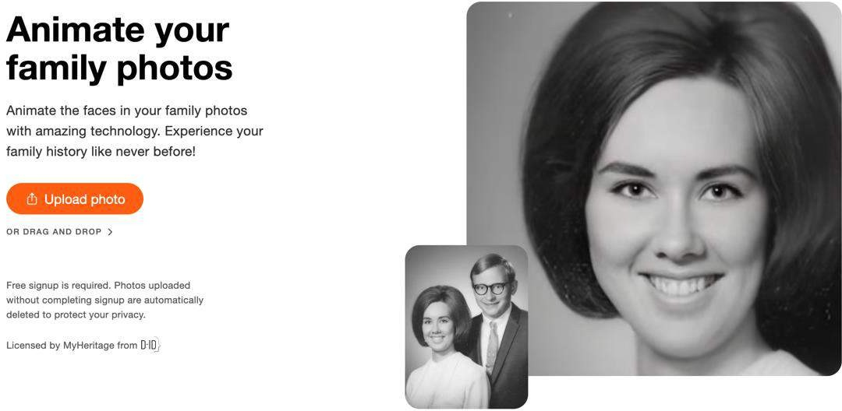
Convolutional Neural Networks
Applications
Deep Nostalgia By MyHeritage
Animates (old) photos
Went viral in February 2021
https://www.myheritage.com/deep- nostalgia https://blog.myheritage.com/2021/02/d eep-nostalgia-goes-viral/

Slide 15
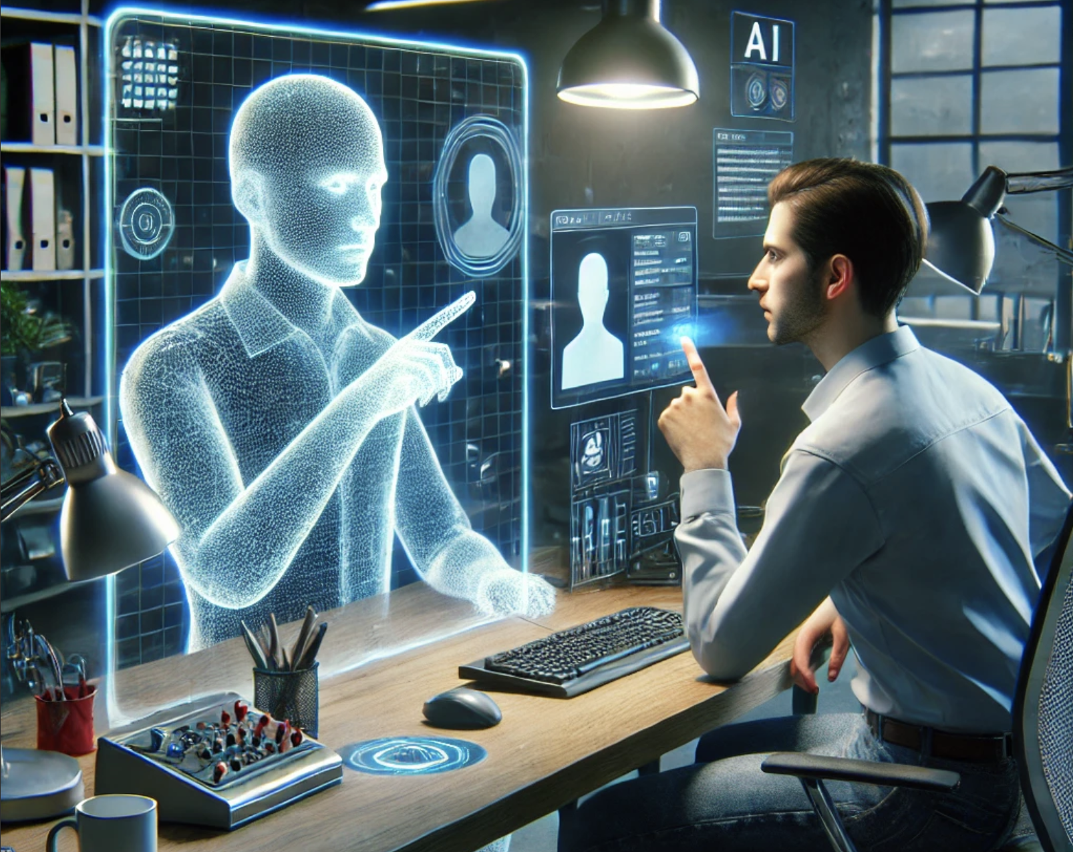
Natural Language Processing Today
Large Language Models (LLMs): These are like super-smart robots that understand and generate human language. They've read a lot of books, articles, and websites to learn how we talk and write. Because of this, they can help us with tasks like writing essays, answering questions, and even having conversations.
Transformers: Think of transformers as a new kind of smart engine for understanding language. Traditional engines were like simple bikes, but transformers are like advanced cars. They can handle a lot more information at once, making them much better at understanding the context and meaning of sentences.
BERT (Bidirectional Encoder Representations from Transformers): Imagine reading a book by only looking at one word at a time versus understanding the whole sentence at once. BERT looks at the words before and after a particular word to understand its meaning in a sentence. This helps computers understand language more like humans do.
GPT (Generative Pre-trained Transformer): GPT models, like the one you're chatting with, are designed to generate human-like text. They can write stories, poems, and even code. They are pre-trained on a massive amount of text data, which helps them generate coherent and contextually relevant text.
Attention Mechanism: This is like a highlighter for important words in a sentence. When reading a paragraph, you might focus more on key words to understand the main idea. The attention mechanism helps language models pay more attention to important parts of a sentence, improving their understanding and generation of text.
Math Problems with GTO-4o
https://www.youtube.com/watch?v=_nSmkyDNulk

Slide 16
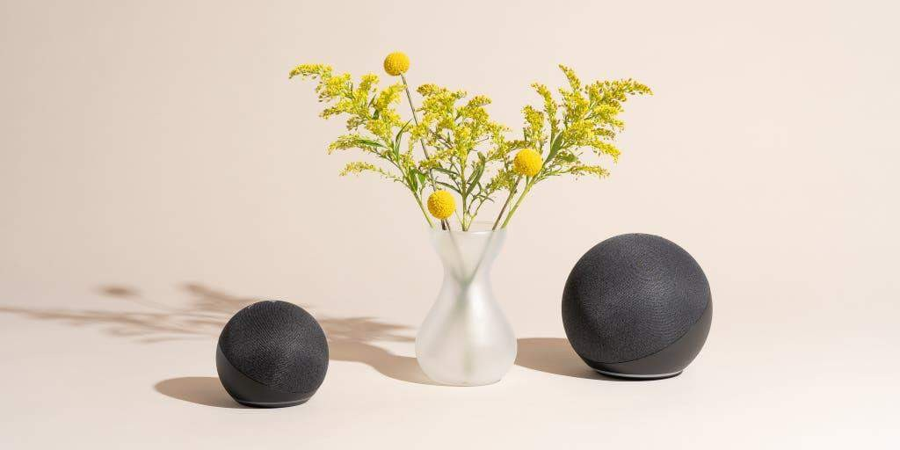
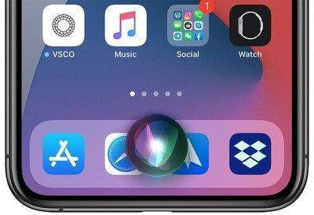
Amazon’s Alexa, Google’s Home, SIRI

Slide 17
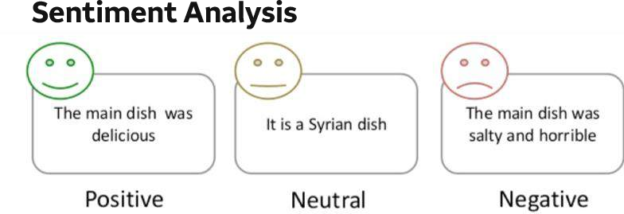

Slide 18
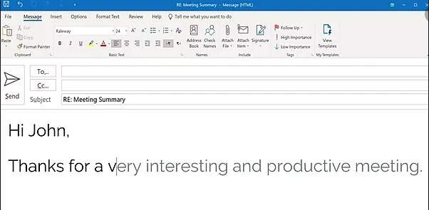
Speed up word processing and facilitate text dictation

Slide 19
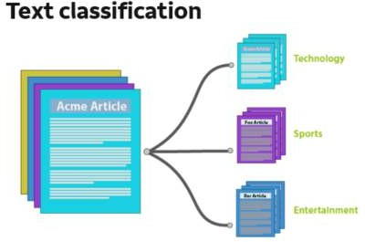
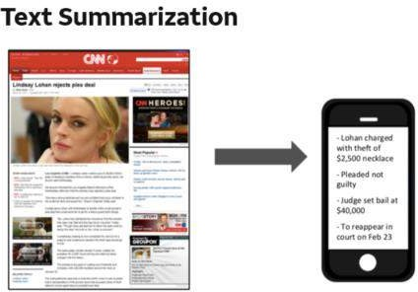

Slide 20
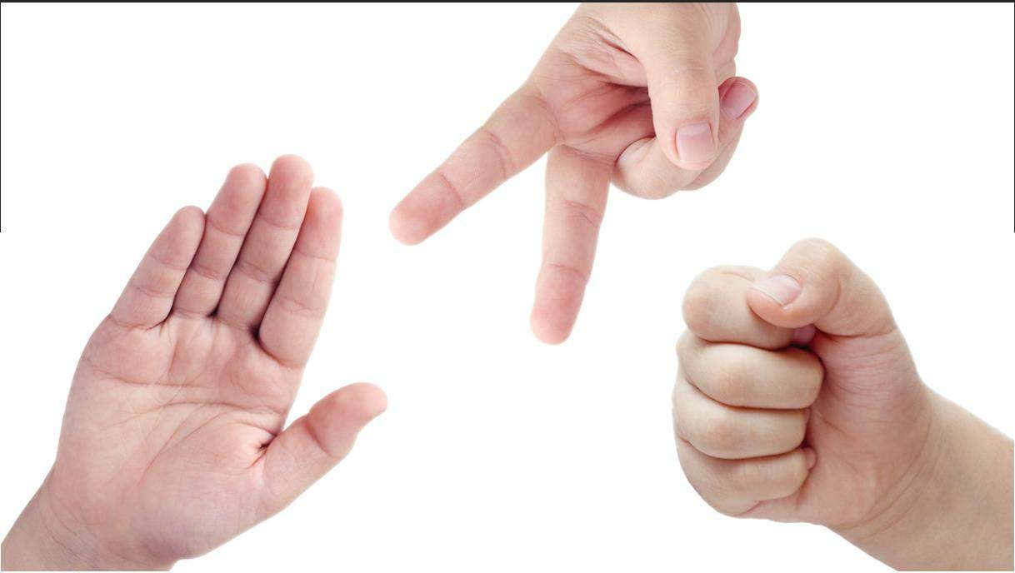
Final Team Project: Scissors, Rock and Paper Image Recognition
Github location: https://github.com/RudyMartin/dsai-2024/tree/main/MVPS/Camp-Rock-Paper-Scissors

Slide 21
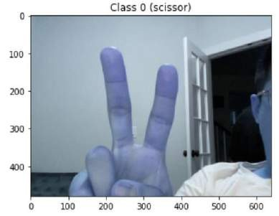
Final Team Project: Scissors, Rock and Paper Image Recognition
Team Task: build a Neural Network (NN) Model to recognize Scissor, Rock and Paper in images
Training Data needs to be collected by the students using the provided program to take pictures.
The basic structure of the NN is provided in a template.
Students need to try different model parameters, initializations, and optimization methods in order to have the best model performance.

Slide 22
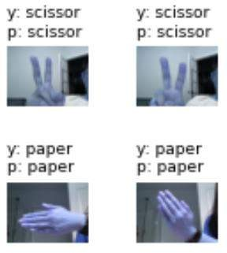
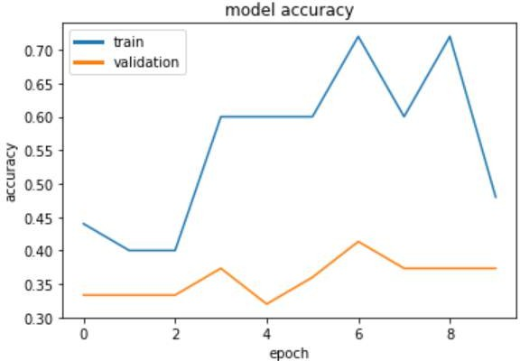
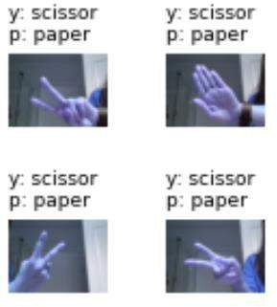
Final Team Project: Scissors, Rock and Paper Image Recognition
Assessment of performance: accuracy on a provided
testing data set
Presentation Template is also provided
Right prediction
Wrong
prediction
25

Slide 23
Final Team Project: Scissors, Rock and Paper Image Recognition or AI-StartUp
Github Location: https://github.com/RudyMartin/dsai-2024/blob/main/MVPS/Camp-Rock-Paper-Scissors
Recommended Project: Presentations
(pick one)
1) Easy: Your team improves on current code
https://github.com/RudyMartin/dsai-2024/blob/main/MVPS/Student-Presentations/NN%20team%20project%20presentation%20template%20for%20students.pptx
2) Harder: Your team will need to provide your own code and research
https://github.com/RudyMartin/dsai-2024/blob/main/MVPS/Student-Presentations/AI_Startup_Template.pptx
Project: introduction and data collection
data_prep_v3_from_student_pics.ipynb (Create first baseline model. Wit original images.)
Project: Model initialization and structure
baseline_2024_project_template.ipynb
data_prep_v3_from_zip.ipynb. (Create second baseline model, by swapping out original photos.)
Project: Model parameter tuning and optimization
tuned_2024_project_template.ipynb (Create tuned model with process and algorithm changes.)

Slide 24
Platform Set-up (Google Colab)
log out all of your google accounts (google drive , gmail, etc.) and log into one personal google
account for this camp in google drive (drive.google.com)
Go to
https://github.com/RudyMartin/dsai-2024/blob/main/Mounting_Drive_and_Cloning_Repository.ipynb
And click on open in Colab Button
If that does not work, download the notebook and upload it in your google drive.
Select 'Mounting_Drive_and_Cloning_Repository.ipynb' file in google drive and open in Colab. Run the cells in the notebook, following the directions. This should mount your Google Drive, and clone the rest of this repository into your drive, making all the camp materials easily accessible.
Log on to https://drive.google.com. You should see a new folder called dsai-2024, and within that folder should be a copy of this repositor under the “MVPS” folder
You can open any of the notebooks in the folder by Right Click -> Open With... -> Google
Colabratory. You may need to click "OK" to connect to Colab the first time.

Slide 25
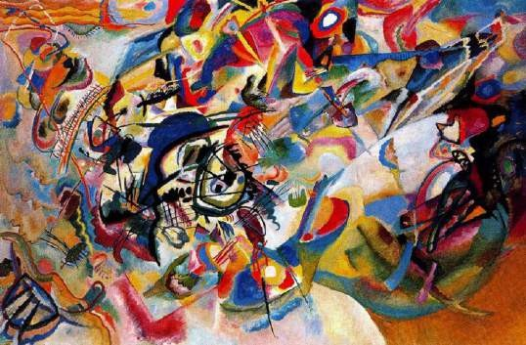
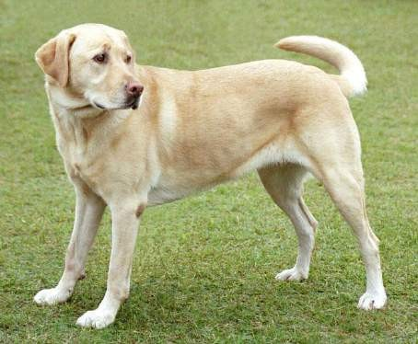
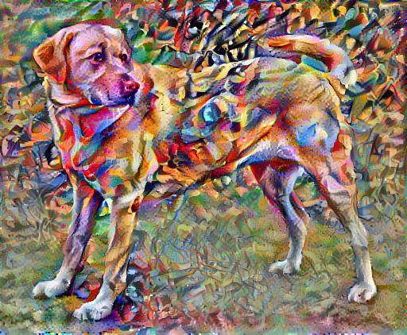
Style Transfer Example (optional)
+
=
Open: style_transfer.ipynb in google colab
https://github.com/RudyMartin/dsai-2024/blob/main/MVPS/Session-Materials/Intro%20to%20Data%20Science/style_transfer.ipynb

Slide 26
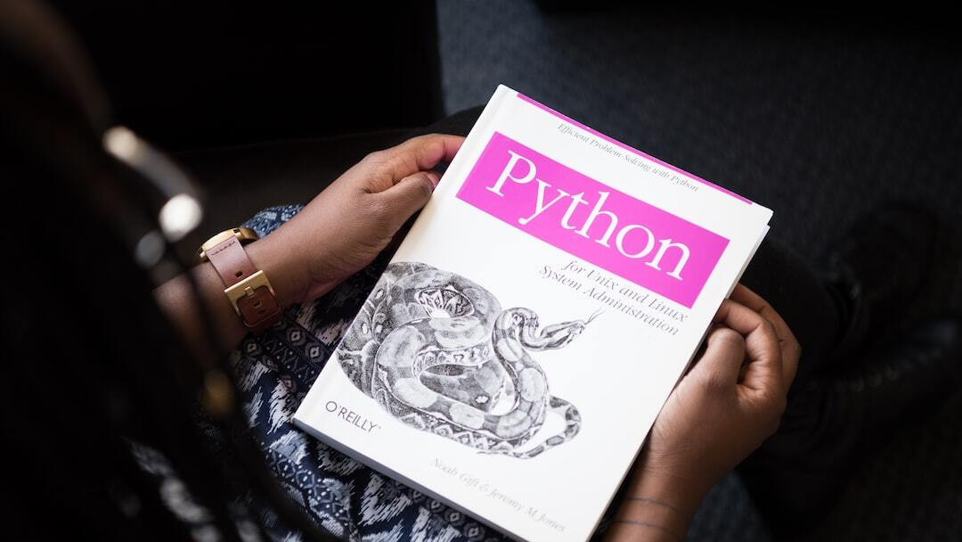
Engaging Data Science Exercises
Photo by Christina @ wocintechchat.com on Unsplash
Stats Snap: Objective: Introduces students to basic statistical analysis using Python. Description: Students will generate a dataset and calculate its mean, median, and standard deviation, gaining insight into fundamental statistical concepts.
TempTrack: Objective: Teaches students how to visualize data by plotting a line graph. Description: This exercise helps students understand how to use Matplotlib for plotting daily temperatures over a week, showcasing the power of visual data representation.
Score Predictor: Objective: Introduces students to simple linear regression as a tool for predicting outcomes based on input variables. Description: Students will use hours studied to predict exam scores, learning the basics of linear regression modeling and data correlation.

Slide 27
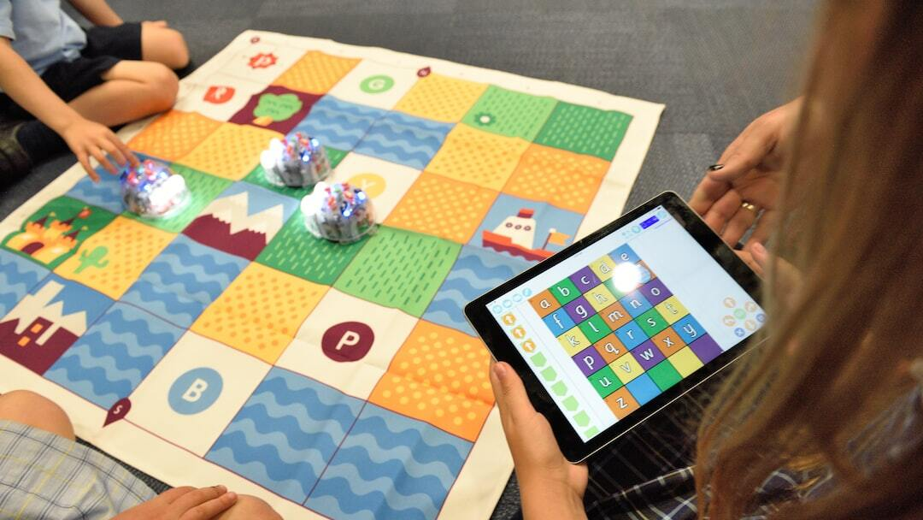
Introduction to ‘Data Detective: The Mystery Object Guessing Game’
Photo by stem.T4L on Unsplash
Welcome to 'Data Detective': A fun and interactive guessing game where you play the role of a detective trying to uncover the secret identity of a mysterious object.
Objective: Guess a secret object chosen randomly from a list. You have a limited number of guesses to figure out what the object is.
Gameplay: Input guesses through an interactive interface and receive feedback. Keep guessing until correct or out of attempts.
Data Science Twist: Analyze guess statistics and calculate probabilities to see how likely each object was to be guessed.
Learning Outcomes: Develop critical thinking, understand basic data handling and probability, and engage with interactive learning.
Why Play?: Learn to think like a data scientist, gain practical experience with statistical concepts, and sharpen analytical thinking skills in a fun environment.

